Slide 1

Databases
denis.mccarthy@tus.ie
RoomU302

Slide 2
Chapter 5
SQL

Slide 3
SQL
Data Definition
Basic Query Structure
Set Operations
Aggregate Functions
Null Values
Nested Subqueries
Complex Queries
Modification of the Database
Joined Relations**
Referential Integrity
Notes:
1

Slide 4
History
IBM Sequel language developed as part of System R project at the IBM San Jose Research Laboratory
Renamed Structured Query Language (SQL)
ANSI and ISO standard SQL:
SQL-86
SQL-89
SQL-92
SQL:1999 (language name became Y2K compliant!)
SQL:2003
SQL:2006
SQL:2008
SQL:2011 (mostly to do with time queries)
SQL:2016 (pattern matching, polymorphic functions and JSON)

Slide 5
History
Commercial systems offer most, if not all, SQL-92 features, plus varying feature sets from later standards and special proprietary features.
Not all examples here may work on your particular system.

Slide 6
Data Definition Language
Allows the specification of not only a set of relations but also information about each relation, including:
The schema for each relation.
The domain of values associated with each attribute.
Integrity constraints
The set of indices to be maintained for each relations.
Security and authorization information for each relation.
The physical storage structure of each relation on disk.*

Slide 7
Domain Types in SQL
char (n). Fixed length character string, with user-specified length n.
varchar (n). Variable length character strings, with user-specified maximum length n.
int. Integer (a finite subset of the integers that is machine-dependent).
smallint. Small integer (a machine-dependent subset of the integer domain type).

Slide 8
Domain Types in SQL
numeric (p, n). Fixed point number, with user-specified precision of p digits, with n digits to the right of decimal point.
real, double precision. Floating point and double-precision floating point numbers, with machine-dependent precision.
float (n). Floating point number, with user-specified precision of at least n digits.
More are covered later.

Slide 9
Create Table Construct
An SQL relation is defined using the create table command:
create table r (A₁ D₁, A₂ D₂, ..., A_{n} D_{n}, (integrity-constraint₁), ..., (integrity-constraint_{k}));
r is the name of the relation
each A_{i} is an attribute name in the schema of relation r
D_{i} is the data type of values in the domain of attribute A_{i}

Slide 10
Example of creating a table
Example:
create table branch (branch_name char(15) not null, branch_city char(30), assets integer)

Slide 11
Integrity Constraints in Create Table
not null
primary key (A₁, ..., A_{n} )
Example: Declare branch_name as the primary key for branch
create table branch (branch_name char(15), branch_city char(30), assets integer, primary key (branch_name))
primary key declaration on an attribute automatically ensures not null in SQL-92 onwards, needs to be explicitly stated in SQL-89

Slide 12
Drop and Alter Table Constructs
The drop table command deletes all information about the dropped relation from the database.
The alter table command is used to add attributes to an existing relation:
alter table r add A D
where A is the name of the attribute to be added to relation r and D is the domain of A.
All tuples in the relation are assigned null as the value for the new attribute.

Slide 13
Drop and Alter Table Constructs
The alter table command can also be used to drop attributes of a relation:
alter table r drop A
where A is the name of an attribute of relation r
Dropping of attributes not supported by many databases

Slide 14
Basic Query Structure
SQL is based on set and relational operations with certain modifications and enhancements
A typical SQL query has the form:
select A₁, A₂, ..., A_{n} from r₁, r₂, ..., r_{m} where P
A_{i} represents an attribute
r_{i} represents a relation
P is a predicate.
Notes:
2

Slide 15
Basic Query Structure
This query is equivalent to the relational algebra expression.
The result of an SQL query is a relation.

Slide 16
The select Clause
The select clause lists the attributes desired in the result of a query
corresponds to the projection operation of the relational algebra
Example: find the names of all branches in the loan relation: select branch_name from loan
Notes:
3

Slide 17
The select Clause (Cont.)
In the relational algebra, the query would be:
∏_{branch_name} (loan)
NOTE: SQL names are case insensitive (i.e., you may use upper- or lower-case letters.)
Some people use upper case wherever we use bold font.

Slide 18
The select Clause (Cont.)
SQL allows duplicates in relations as well as in query results.
To force the elimination of duplicates, insert the keyword distinct after select.
Find the names of all branches in the loan relations, and remove duplicates
select distinct branch_name from loan
Notes:
4

Slide 19
The select Clause (Cont.)
The keyword all specifies that duplicates not be removed.
select all branch_name from loan
An asterisk in the select clause denotes “all attributes”
select * from loan

Slide 20
The select Clause (Cont.)
The select clause can contain arithmetic expressions involving the operation, +, –, ∗, and /, and operating on constants or attributes of tuples.
The query:
select loan_number, branch_name, amount ∗ 100 from loan
would return a relation that is the same as the loan relation, except that the value of the attribute amount is multiplied by 100.
Notes:
5

Slide 21
The where Clause
The where clause specifies conditions that the result must satisfy
Corresponds to the selection predicate of the relational algebra.
To find all loan number for loans made at the Perryridge branch with loan amounts greater than €1200.
select loan_number from loan where branch_name = ‘ Perryridge’ and amount > 1200
Notes:
6

Slide 22
The where Clause (Cont.)
Comparison results can be combined using the logical connectives and, or, and not.
Comparisons can be applied to results of arithmetic expressions.

Slide 23
The where Clause (Cont.)
SQL includes a between comparison operator
Example: Find the loan number of those loans with loan amounts between €90,000 and €100,000 (that is, ≥ €90,000 and ≤ €100,000)
select loan_number from loan where amount between 90000 and 100000
Alternative:
select loan_number from loan where amount >= 90000 and amount <=100000
Notes:
7

Slide 24

The from Clause
The from clause lists the relations involved in the query
Corresponds to the Cartesian product operation of the relational algebra.
Find the Cartesian product borrower X loan
select ∗ from borrower, loan
Find the name, loan number and loan amount of all customers having a loan at the Perryridge branch.
select customer_name, borrower.loan_number, amount from borrower, loan where borrower.loan_number = loan.loan_number and branch_name = ‘Perryridge’
Natural join
Notes:
8

Slide 25
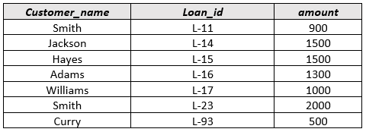
The Rename Operation
The SQL allows renaming relations and attributes using the as clause:
old-name as new-name
Find the name, loan number and loan amount of all customers; rename the column name loan_number as loan_id.
select customer_name, borrower.loan_number as loan_id, amount from borrower, loan where borrower.loan_number = loan.loan_number
Notes:
9

Slide 26
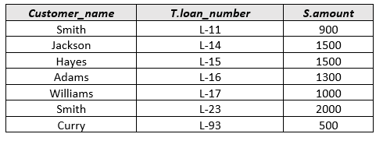
Tuple Variables
Tuple variables are defined in the from clause via the use of the as clause.
Find the customer names and their loan numbers for all customers having a loan at some branch.
select customer_name, T.loan_number, S.amount from borrower as T, loan as S where T.loan_number = S.loan_number
Notes:
10

Slide 27

String Operations
SQL includes a string-matching operator for comparisons on character strings. The operator “like” uses patterns that are described using two special characters:
percent (%). The % character matches any substring.
underscore (_). The _ character matches any character.
Find the names of all customers whose street includes the substring “Main”.
select customer_name from customer where customer_street like ‘%Main%’

Slide 28

String Operations
Find the details of all customers whose name includes the substring “on”.
select * from customer where customer_name like ‘%on%’
Find the details of all customers whose name starts with a “J”
select * from customer where customer_name like ‘J%’

Slide 29
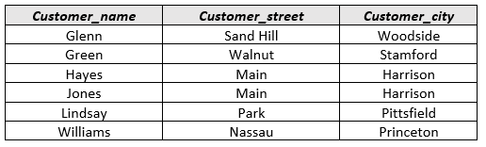
String Operations
Find the details of all customers whose street has its second letter as an “a”
select * from customer where customer_name like ‘_a%’

Slide 30
String Operations (Cont.)
SQL supports a variety of string operations such as
concatenation (using “||”)
converting from upper to lower case (and vice versa)
finding string length, extracting substrings, etc.

Slide 31

Ordering the Display of Tuples
List in alphabetic order the names of all customers having a loan in Perryridge branch
select distinct customer_name from borrower, loan where borrower loan_number = loan.loan_number and branch_name = ‘Perryridge’ order by customer_name
We may specify desc for descending order or asc for ascending order, for each attribute; ascending order is the default.
Example: order by customer_name desc

Slide 32
Set Operations
The set operations union, intersect *, and except * operate on relations and correspond to the relational algebra operations ∪, ∩, −.
Each of the above operations automatically eliminates duplicates; to retain all duplicates use the corresponding multiset versions union all, intersect all * and except all *.
* = MySQL does not support these commands; we will look at a workaround during lab sessions.

Slide 33
Set Operations (Cont.)
Suppose a tuple occurs m times in r and n times in s, then, it occurs:
m + n times in r union all s
min (m, n) times in r intersect all s
max(0, m – n) times in r except all s

Slide 34
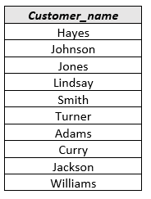

Set Operations
Find all customers who have a loan, an account, or both:
(select customer_name from depositor) union (select customer_name from borrower)
Find all customers who have both a loan and an account.
(select customer_name from depositor) intersect (select customer_name from borrower)

Slide 35
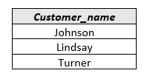
Set Operations (Cont.)
Find all customers who have an account but no loan.
(select customer_name from depositor) except (select customer_name from borrower)

Slide 36
Aggregate Functions
These functions operate on the multiset of values of a column of a relation, and return a value
avg: average value min: minimum value max: maximum value sum: sum of values count: number of values

Slide 37



Aggregate Functions (Cont.)
Find the average account balance at the Perryridge branch.
select avg (balance) from account where branch_name = ‘Brighton’
Find the number of tuples in the customer relation.
select count (*) from customer
Find the number of depositors in the bank.
select count (distinct customer_name) from depositor

Slide 38
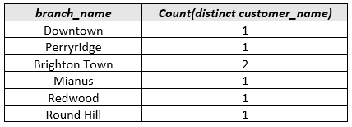
Aggregate Functions – Group By
Find the number of depositors for each branch.
select branch_name, count (distinct customer_name) from depositor, account where depositor.account_number = account.account_number group by branch_name
Note: Attributes in select clause outside of aggregate functions must appear in group by list

Slide 39

Aggregate Functions – Having Clause
Find the names of all branches where the average account balance is more than €800.
select branch_name, avg (balance) from account group by branch_name having avg (balance) > 800
Note: predicates in the having clause are applied after the formation of groups whereas predicates in the where clause are applied before forming groups

Slide 40
Null Values
It is possible for tuples to have a null value, denoted by null, for some of their attributes
null signifies an unknown value or that a value does not exist.
The predicate is null can be used to check for null values.
Example: Find all loan number which appear in the loan relation with null values for amount.
select loan_number from loan where amount is null

Slide 41
Nulls (Cont.)
The result of any arithmetic expression involving null is null
Example: 5 + null returns null
However, aggregate functions simply ignore nulls
Any comparison with null returns unknown
Example: 5 < null or null <> null or null = null

Slide 42
Null Values and Three Valued Logic
Three-valued logic using the truth value unknown:
OR: (unknown or true) = true,
(unknown or false) = unknown (unknown or unknown) = unknown
AND: (true and unknown) = unknown, (false and unknown) = false, (unknown and unknown) = unknown
NOT: (not unknown) = unknown
“P is unknown” evaluates to true if predicate P evaluates to unknown

Slide 43

Null Values and Aggregates
Result of where clause predicate is treated as false if it evaluates to unknown
Total all loan amounts
select sum (amount ) from loan
Above statement ignores null amounts
Result is null if there is no non-null amount
All aggregate operations except count(*) ignore tuples with null values on the aggregated attributes.

Slide 44
Nested Subqueries
SQL provides a mechanism for the nesting of subqueries.
A subquery is a select-from-where expression that is nested within another query.
A common use of subqueries is to perform tests for set membership, set comparisons, and set cardinality.

Slide 45

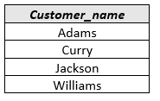
Example Query
Find all customers who have both an account and a loan at the bank.
select distinct customer_name from borrower where customer_name in (select customer_name from depositor )
Find all customers who have a loan at the bank but do not have an account at the bank
select distinct customer_name from borrower where customer_name not in (select customer_name from depositor )

Slide 46

Set Comparison
Find all branches that have greater assets than some branch located in Brooklyn.
select distinct T.branch_name from branch as T, branch as S where T.assets > S.assets and S.branch_city = ‘ Brooklyn’
Same query using > some clause
select branch_name from branch where assets > some (select assets from branch where branch_city = ‘Brooklyn’)

Slide 47
Definition of Some Clause
F <comp> some r ⇔ ∃ t ∈ r such that (F <comp> t ) Where <comp> can be: <, ≤, >, =, ≠
0
(5 < some
5
) = true
(read: 5 < some tuple in the relation)
6
0
(5 < some
5
) = false
0
(5 = some
) = true
5
0
(5 ≠ some
5
) = true (since 0 ≠ 5)
(= some) ≡ in
However, (≠ some) ≡ not in

Slide 48

Example Query
Find the names of all branches that have greater assets than all branches located in Brooklyn.
select branch_name from branch where assets > all (select assets from branch where branch_city = ‘Brooklyn’)

Slide 49
Definition of all Clause
F <comp> all r ⇔ ∀ t ∈ r (F <comp> t)
0
(5 < all
5
) = false
6
6
(5 < all
) = true
10
4
(5 = all
) = false
5
4
(5 ≠ all
) = true (since 5 ≠ 4 and 5 ≠ 6)
6
(≠ all) ≡ not in
However, (= all) ≡ in

Slide 50
Test for Empty Relations
The exists construct returns the value true if the argument subquery is nonempty.
exists r ⇔ r ≠ Ø
not exists r ⇔ r = Ø

Slide 51

Example Query
Find all customers who have an account at all branches located in Brooklyn.
select distinct S.customer_name from depositor as S where not exists ( (select branch_name from branch where branch_city = ‘Brooklyn’) except (select R.branch_name from depositor as T, account as R where T.account_number = R.account_number and S.customer_name = T.customer_name ))
Note that X – Y = Ø ⇔ X ⊆ Y
Note: Cannot write this query using = all and its variants

Slide 52

Test for Absence of Duplicate Tuples
The unique construct tests whether a subquery has any duplicate tuples in its result.
Find all customers who have at most one account at the Perryridge branch.
select T.customer_name
from depositor as T
where unique (
select R.customer_name from account, depositor as R where T.customer_name = R.customer_name and R.account_number = account.account_number and account.branch_name = ‘ Perryridge’ )

Slide 53

Derived Relations
SQL allows a subquery expression to be used in the from clause
Find the average account balance of those branches where the average account balance is greater than €800.
select branch_name, avg_balance from (select branch_name, avg (balance) from account group by branch_name ) as branch_avg ( branch_name, avg_balance ) where avg_balance > 800

Slide 54
Derived Relations (Cont.)
Note that we do not need to use the having clause, since we compute the temporary (view) relation branch_avg in the from clause, and the attributes of branch_avg can be used directly in the where clause.

Slide 55

With Clause
The with clause provides a way of defining a temporary view whose definition is available only to the query in which the with clause occurs.
Find all accounts with the maximum balance with max_balance (value) as select max (balance) from account select account_number from account, max_balance where account.balance = max_balance.value

Slide 56
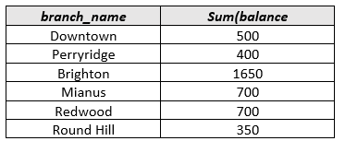


Complex Query using With Clause
Find all branches where the total account deposit is greater than the average of the total account deposits at all branches.
with branch_total (branch_name, value) as select branch_name, sum (balance) from account group by branch_name with branch_total_avg (value) as select avg (value) from branch_total select branch_name from branch_total, branch_total_avg where branch_total.value >= branch_total_avg.value

Slide 57
Modification of the Database – Deletion
Delete all account tuples at the Perryridge branch
delete from account where branch_name = ‘Perryridge’
Delete all accounts at every branch located in the city ‘Needham’.
delete from account where branch_name in (select branch_name from branch where branch_city = ‘Needham’)

Slide 58
Example Query
Delete the record of all accounts with balances below the average at the bank.
delete from account where balance < (select avg (balance ) from account )
Problem: as we delete tuples from deposit, the average balance changes
Solution used in SQL:
1. First, compute avg balance and find all tuples to delete
2. Next, delete all tuples found above (without recomputing avg or retesting the tuples)

Slide 59
Modification of the Database – Insertion
Add a new tuple to account
insert into account values (‘A-9732’, ‘Perryridge’,1200)
or equivalently
insert into account (branch_name, balance, account_number) values (‘Perryridge’, 1200, ‘A-9732’)
Add a new tuple to account with balance set to null
insert into account values (‘A-777’,‘Perryridge’, null )

Slide 60
Modification of the Database – Insertion
Provide as a gift for all loan customers of the Perryridge branch, a €200 savings account. Let the loan number serve as the account number for the new savings account
insert into account select loan_number, branch_name, 200 from loan where branch_name = ‘Perryridge’ insert into depositor select customer_name, loan_number from loan, borrower where branch_name = ‘ Perryridge’ and loan.account_number = borrower.account_number

Slide 61
Modification of the Database – Insertion
The select from where statement is evaluated fully before any of its results are inserted into the relation (otherwise queries like insert into table1 select * from table1 would cause problems)

Slide 62
Modification of the Database – Updates
Increase all accounts with balances over €10,000 by 6%, all other accounts receive 5%.
Write two update statements:
update account set balance = balance ∗ 1.06 where balance > 10000
update account set balance = balance ∗ 1.05 where balance ≤ 10000
The order is important
Can be done better using the case statement (next slide)

Slide 63
Case Statement for Conditional Updates
Same query as before: Increase all accounts with balances over €10,000 by 6%, all other accounts receive 5%.
update account set balance = case when balance <= 10000 then balance *1.05 else balance * 1.06 end

Slide 64
Joined Relations**
Join operations take two relations and return as a result another relation.
These additional operations are typically used as subquery expressions in the from clause
Join condition – defines which tuples in the two relations match, and what attributes are present in the result of the join.
Join type – defines how tuples in each relation that do not match any tuple in the other relation (based on the join condition) are treated.

Slide 65
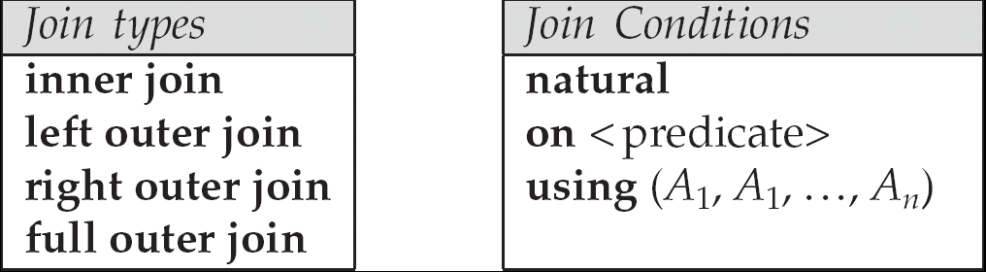
Joined Relations** (Cont.)

Slide 66
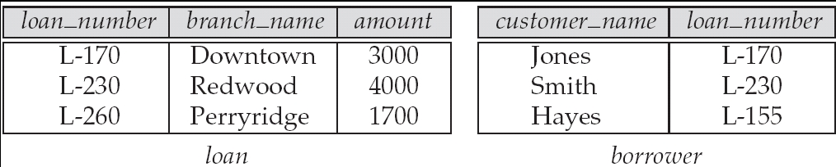
Joined Relations – Datasets for Examples
Relation loan
Relation borrower
Note: borrower information missing for L-260 and loan information missing for L-155

Slide 67
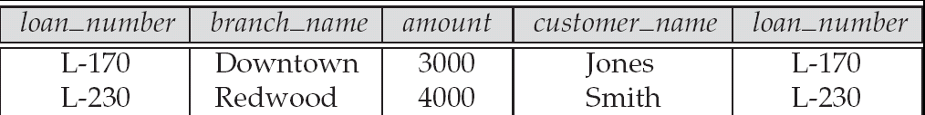
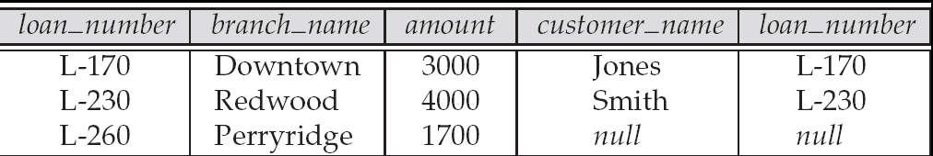
Joined Relations – Examples
loan inner join borrower on loan.loan_number = borrower.loan_number
loan left outer join borrower on loan.loan_number = borrower.loan_number

Slide 68
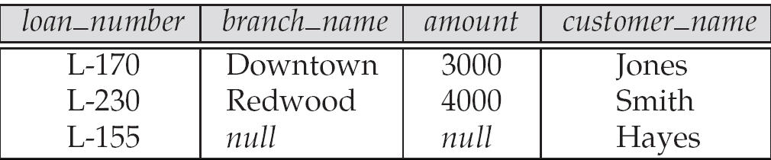
Joined Relations – Examples
loan natural inner join borrower
loan right outer join borrower

Slide 69
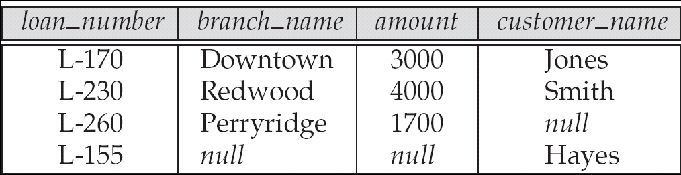
Joined Relations – Examples
loan full outer join borrower using (loan_number)
Find all customers who have either an account or a loan (but not both) at the bank.
select customer_name from (depositor natural full outer join borrower ) where account_number is null or loan_number is null

Slide 70
Referential Integrity
Ensures that a value that appears in one relation for a given set of attributes also appears for a certain set of attributes in another relation.
Example: If “Perryridge” is a branch name appearing in one of the tuples in the account relation, then there exists a tuple in the branch relation for branch “Perryridge”.

Slide 71
Referential Integrity (Cont.)
Primary and candidate keys and foreign keys can be specified as part of the SQL create table statement:
The primary key clause lists attributes that comprise the primary key.
The unique key clause lists attributes that comprise a candidate key.
The foreign key clause lists the attributes that comprise the foreign key and the name of the relation referenced by the foreign key. By default, a foreign key references the primary key attributes of the referenced table.

Slide 72
Referential Integrity in SQL – Example
create table customer (customer_name char(20), customer_street char(30), customer_city char(30), primary key (customer_name ))
create table branch (branch_name char(15), branch_city char(30), assets numeric(12,2), primary key (branch_name ))

Slide 73
Referential Integrity in SQL – Example (Cont.)
create table account (account_number char(10), branch_name char(15), balance integer, primary key (account_number), foreign key (branch_name) references branch )
create table depositor (customer_name char(20), account_number char(10), primary key (customer_name, account_number), foreign key (account_number ) references account, foreign key (customer_name ) references customer )

